Slide 1
Close Reading

Slide 2
Close Reading
Every detail matters, whether author intended them or not.
Developed in reference to poetry
Originally meant to be only what is in the text.
No context, historical, personal, authorial.

Slide 3
Close Reading
Has changed
Now not just for poetry, but for all types of media.
All sorts of contexts can provide evidence and material.
At its core, it’s still interpretive

Slide 4
Hermeneutic Circle
Describes how interpretation happens.
Your sense of the whole text affect your reading of the parts.
Your sense of the parts reshape your sense of the whole as your reading it.
Constantly shifting and reshaping sense of interpretation.

Slide 5
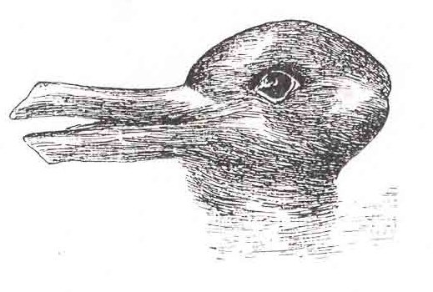
Weisstein, Eric W. "Rabbit-Duck Illusion." From MathWorld--A Wolfram Web Resource.
http://mathworld.wolfram.com/Rabbit-DuckIllusion.html
Notes:
Weisstein, Eric W. "Rabbit-Duck Illusion." From MathWorld--A Wolfram Web Resource. http://mathworld.wolfram.com/Rabbit-DuckIllusion.html

Slide 6
Hermeneutic Circle
Now it’s not just all internal to the text.
Different series of part-whole relationships.
Text to historical context
Text to other texts
Text to yourself
Text to author
All changing as we read.

Slide 7
Hermeneutic Circle
Describes how we read.
As we read, things change in our mind and affect how we’re reading.
Our sense of the text and its context are constantly changing.
It’s a fancy party word for a concept you already know.

Slide 8
Close Reading
“All art is quite useless.”
Oscar Wilde

Slide 9
Close Reading
“The first duty in life is to be as artificial as possible. What the second duty is no one has as yet discovered.”
Oscar Wilde

Slide 10
Close Reading
“I have nothing to declare but my own genius”
Oscar Wilde

Slide 11
“Man is least himself when he talks in his own person. Give a man a mask, and he will tell you the truth.”
Oscar Wilde

Slide 12
Close Reading
“All art is quite useless.”
Oscar Wilde

Slide 13
Close Reading
“Either these drapes go or I do”

Slide 14
Close Reading
“For Oscar Wilde posing as a somdomite”
-Queensberry to Wilde
Notes:
The note that

